Slide 1



DAV HACKLAB: SESSION 5
UI/UX MASTERY
Stepping into Professional App Development

Slide 2


The Great Leap Forward
Graduating from basic platforms to Kodular.io – where industry-standard apps are born.

Slide 3


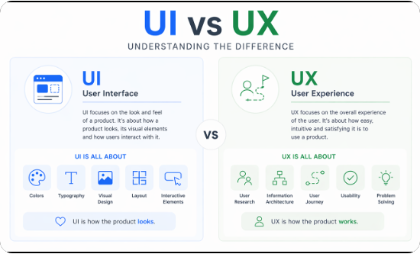
UI VS. UX: THE CORE DISTINCTION
User Interface (UI)
The visuals. It's about buttons, fonts, color palettes, and spacing. Think of it as the "aesthetic" of the car.
User Experience (UX)
The feeling. It's about how easy it is to drive, how comfortable the seats are, and if the engine starts instantly. It's the "logic" of the journey.

Slide 4








THE 4 PILLARS OF PROFESSIONAL UI
1. Alignment
2. Contrast
Nothing should be placed randomly. Every element should have a visual connection with something else on the page.
Make important elements stand out. Use light vs. dark and large vs. small to create a clear "Order of Importance."
3. Whitespace
4. Typography
Let your design breathe. Clutter is the enemy of professional apps. Space creates luxury and clarity.
Limit yourself to 2 fonts. Use weight (Bold/Regular) to distinguish between headers and body text.

Slide 5


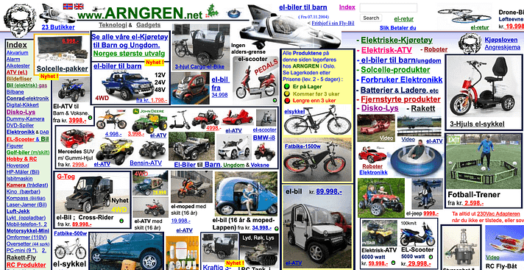

THE "HALL OF SHAME"
Bad UI (Visuals)
Cluttered layouts with zero breathing room.
Using 5+ different colors that clash.
Low contrast (e.g., light gray text on white background).
Bad UX (Flow)
Infinite loading screens with no status bar.
Hidden "Next" or "Submit" buttons.
Asking for too much info before letting a user in.

Slide 6
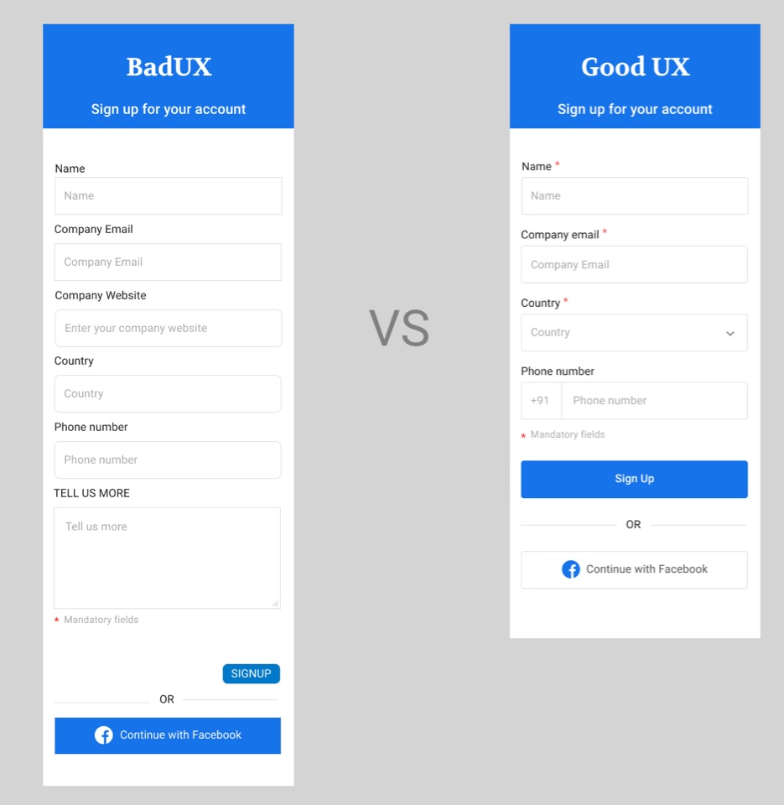

Slide 7



INTERACTIVE: HOST QUESTIONS
Q1: Personal Experience
Q2: The Why
"Think of an app you deleted within 5 minutes. Was it because it looked bad or felt difficult to use?"
"Why do you think apps like Instagram or Spotify look so simple despite having thousands of lines of complex code?"
Q3: Function vs. Form
Q4: Real World Design
"If you had to choose: An app that is beautiful but slow, or an app that is ugly but lightning fast? Why?"
"Look at the Zoom/Google Meet UI right now. What is one thing you would change to make it 'Master-Class'?"

Slide 8




LOGIC VS. EXPERIENCE
The Logic Layer
The Experience Layer
Calculations, databases, and API integrations. It's the "brain" of your app. Vital, but invisible to the user.
Color, typography, and flow. It's the "face" of your app. This determines if a user stays or deletes in 3 seconds.
"You can have the best code, but if it's messy, nobody will use it."

Slide 9
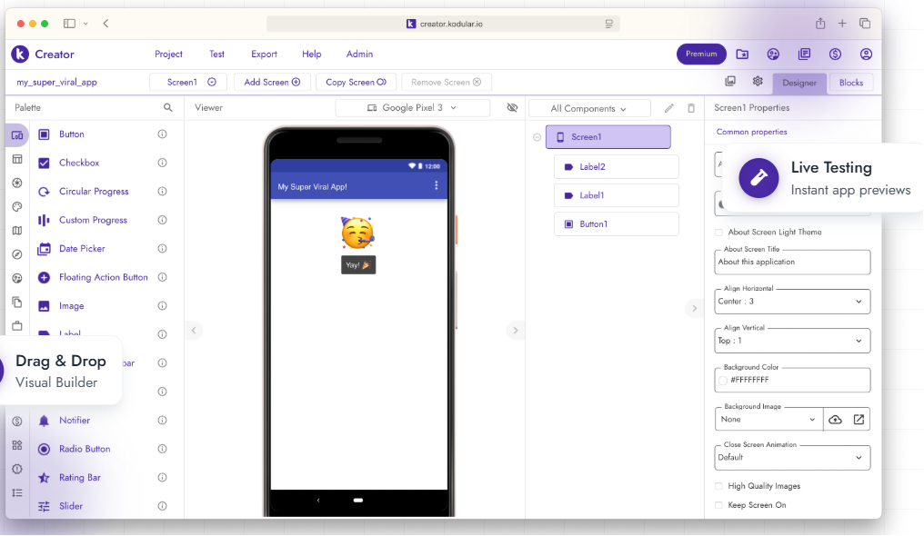

ENTER KODULAR.IO
Professional Android Dev
Kodular is a sophisticated cloud ecosystem designed for elite no-code developers.
175+ Components: From animations to complex databases.
Material Design: Modern Google-standard UI built-in.
Real-time Testing: Instant updates via the Companion App.

Slide 10






THE RULEBOOK OF DESIGN
Visual Hierarchy
Consistency
Clarity
Guiding the user's eye to the most important actions using size, weight, and position.
Maintaining predictable patterns. Buttons and icons should behave the same across every screen.
Removing friction. If a user has to "think" about how to use a feature, the design has failed.

Slide 11

THE ROLE OF GREAT UX
Why Numbers Matter
94%
Research shows that 94% of a user's initial impression of an app is design-related. Furthermore, a 1-second delay in load time or a confusing layout can lead to a 7% drop in user conversions.
FIRST IMPRESSIONS
In the professional world, design is not an extra—it is the foundation.

Slide 12

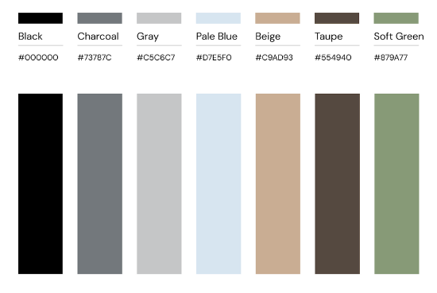
THE SCIENCE OF COLOR
Psychology & Branding
Choosing a palette isn't about "liking" a color; it's about emotional intent.
Green: Growth, Success, Connectivity.
Blue: Trust, Stability, Professionalism.
Dark Tones: Focus, Modernity, Elegance.

Slide 13
COMPARISON: KODULAR VS. OTHERS
Feature | Standard Blocks | Kodular.io
Component Library | Limited (~50) | Advanced (175+)
Design Language | Legacy UI | Material Design 3
Monetization | Basic / None | Full AdMob/IAP Integration
Infrastructure | Academic | Professional Cloud Dev

Slide 14

CORE TEAM HUNT
Ananye, Tejas, and Aviral are looking for the creative eyes behind the screen. Show us your vision.
Any Questions?
Workspace Prep: Kodular.io (Sign in via Google)
#DAVHackLab #UIUXDesign #SummerOfCode

